Slide 1
823
Differentiate between a mixture and a compound.

Slide 2
Differentiate between a mixture and a compound.
Key concepts/skills:
Level 1: Define key vocabulary.
Level 2: Given a substance, differentiate between compounds
and mixtures
Level 3: Understand and differentiate among the levels of
chemical complexity from atoms to molecules to
compound s to mixtures.

Slide 3
Differentiate between a mixture and a compound.
Key vocabulary
Atom
Element
Molecule
Compound
Mixture
Heterogeneous
Homogeneous

Slide 4
Differentiate between a mixture and a compound.
Homogeneous Mixtures Mixtures that are mixed evenly throughout “same throughout”
Example
Salt water
Atom
Smallest part of a substance still having the properties of the substance.
Molecule
Different types of atoms bonded together chemically.
Examples
H₂O, CO₂
Mixture
2 or more compounds mixed but not chem. Bonded. CAN be separated physically.
Examples
Salt water
Salad
Compounds keep Identity
Element
Many identical atoms together.
Examples
Carbon - C
Nitrogen – N
Sodium - Na
Compound
Many identical molecules together. Cannot be separated by physical means.
Examples
Glass of water
Spoon of salt
Elements lose Identity
Heterogeneous Mixtures Mixtures that are NOT mixed evenly. “Different throughout”
Example
Salad

Slide 5
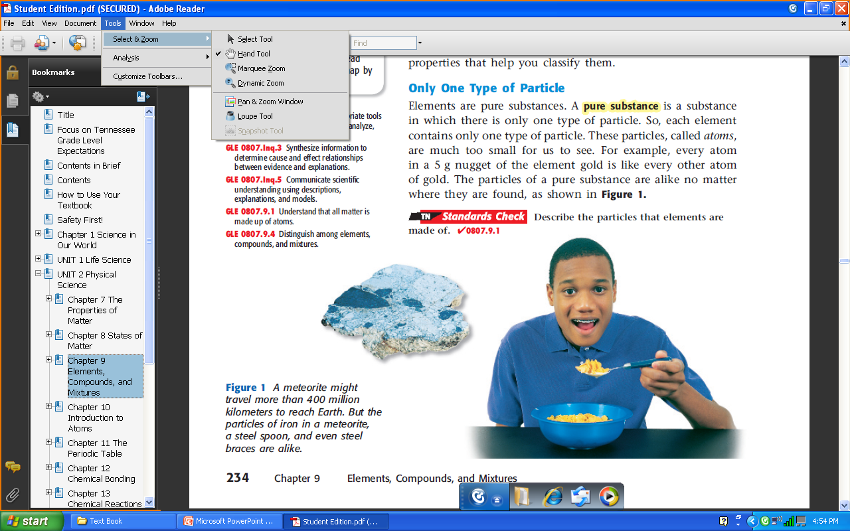
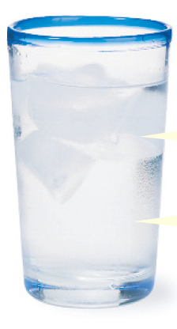
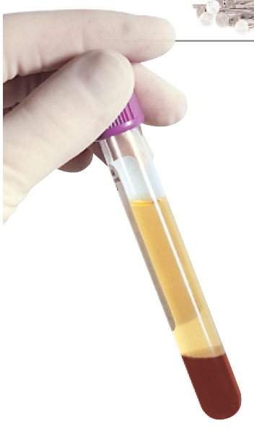
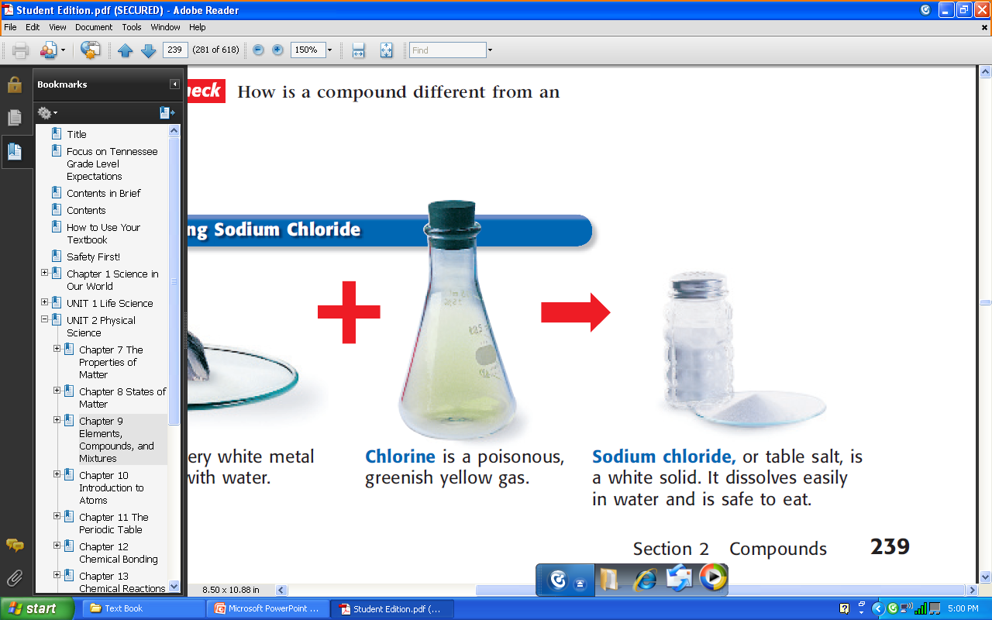
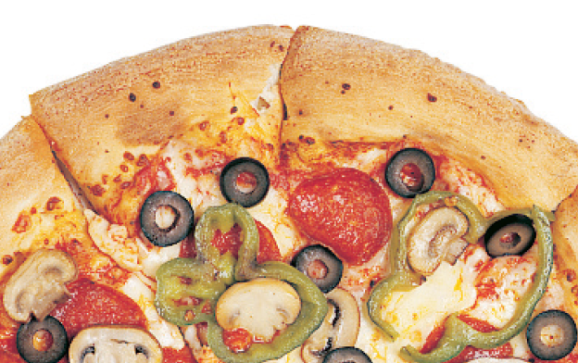
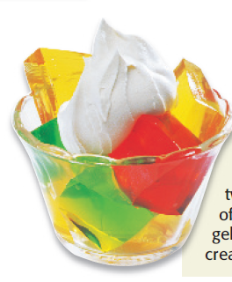
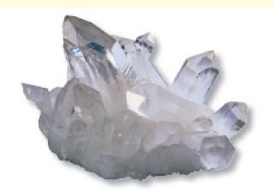
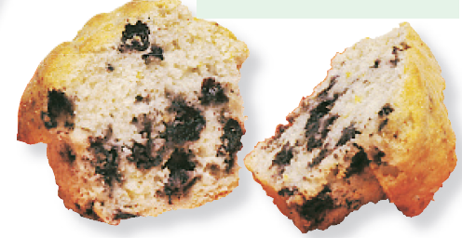
Differentiate between a mixture and a compound.

